Slide 1
Self-Management

Slide 2
Self-Management Systems
An evidence-based intervention to help learners with ASD learn to independently regulate their own behaviors
Learners are taught to discriminate between appropriate and inappropriate behaviors, monitor their own behavior, take their own data, and reward themselves for behaving appropriately
Notes:
Self-management interventions help learners with autism spectrum disorders (ASD) learn to independently regulate their own behaviors and act appropriately in a variety of home, school, and community-based situations. With these interventions, learners with ASD are taught to discriminate between appropriate and inappropriate behaviors, accurately monitor and record their own behaviors, and reward themselves for behaving appropriately. As learners with ASD become more fluent with the self-management system, some of the implementation responsibilities shift from teachers, families, and other practitioners to the learners themselves.

Slide 3

Can be used to:
Reduce inappropriate & interfering behaviors
  Disruptive behaviors
  Not completing school work or chores independently
Increase social, adaptive, & language / communication skills
  Giving compliments to others
  Responding to others
  Increasing on-task behavior
  Initiating interactions
  Increasing play skills
  Conversing with others
Notes:
Self-management interventions can be used to reduce inappropriate and interfering behaviors (disruptive behaviors, not completing school work and chores independently and efficiently, etc.) and to increase social, adaptive, and language/communication skills. Specific skills that were the focus of interventions in the evidence-based studies include giving compliments to others, responding to others, sharing, increasing on-task behavior, initiating interactions, reducing the occurrence of interfering behaviors, promoting daily living skills, increasing play skills, and conversing with others.

Slide 4
Can be used to:
Teach self-regulation (e.g. emotions)
Promotes learning and independence
Teach delayed gratification

Slide 5

Implementing a
Self Management System
Step 1: PREPARE THE SYSTEM
  Identify the target behavior to increase / decrease
    FBA for interfering behaviors
    Operational Definition (observable / measurable)
  Identify Reinforcers
    Variety
    Natural
  Data Collection System / Criterion
    Duration (amt of time)
    Frequency (number)

Slide 6

Implementing a
Self Management System
Step 1: PREPARE THE SYSTEM
  Select recording / cueing devices appropriate for the learner / setting
    Frequency
      Paper / Pencil
      Clickers
      Token Boards
      Paperclips/pennies
      Bracelet
    Interval
      Stopwatch / Timer / Clock

Slide 7
Sample interval recording sheet
Notes:
Sample interval recording sheet
This recording sheet is designed to be used with five time intervals. At the end of each interval, the learner circles whether he or she stayed and played with friends. After the last interval, the learner determines if he or she met the criterion to receive a reinforcer, which in this case is three of the five (60%) intervals.

Slide 8
Step 1: DATA Collection system
Identify Type of System: Interval or Frequency
Interval System – DURATION
  Increase the duration that a desired behavior occurs
    remaining in seat, staying on task, conversing with peers
  Increase the duration that an interfering behavior does NOT occur
    flapping hands, chewing shirt, hitting peers
Notes:
Interval systems. A criterion using an interval system (i.e., the learner must/must not demonstrate the behavior for X number of Y-second intervals) is appropriate in cases where one desires to increase the duration that a desired behavior occurs (e.g., remaining in seat, staying on task, conversing with peers) or an interfering behavior does not occur (e.g., flapping hands, chewing shirt, hitting peers). If an interval system is used, the initial length of the interval should be set so that there is a high likelihood that the learner will be successful.
The best way to determine the initial length of the interval is to observe the learner before the intervention begins and determine the average length of time the learner can be successful without support from others. The initial interval length should be equal to or slightly less than that average. For example, if the goal is to increase the length of time a learner sits in his seat without getting up, and it is determined that, on average, the learner stays in his seat for one minute before getting up, then beginning the self-management system with a one-minute interval or slightly less (e.g., 45 seconds) makes sense. After the interval length is determined, the initial session length during which the self-management system will be used should be determined and divided into intervals of the pre-determined length. The initial number of intervals during which the learner must be successful also should be set.
Continuing with the sitting example, if the self-management system will initially be used for a six-minute session, and these six minutes are divided into six one-minute intervals, the initial criterion could be set such that the learner must stay sitting in his seat for three of the six (50%) one-minute intervals.

Slide 9
Step 1: DATA Collection system
FREQUENCY system – e.g., raising hand in class, taking bites of food, asking peers questions
  Frequency for increased behavior
    The learner must demonstrate the behavior X number of times in a given time period to earn the reinforcer.
  Frequency for decreased behavior
    The learner must demonstrate the behavior no more than X number of times in a given time period to earn the reinforcer
Notes:
Frequency systems. When the frequency of a behavior needs to be increased or decreased (e.g., raising hand in class, taking bites of food, asking peers questions), a frequency criterion should be considered. Examples of frequency criteria for behaviors that need to be increased and decreased are provided.

Slide 10
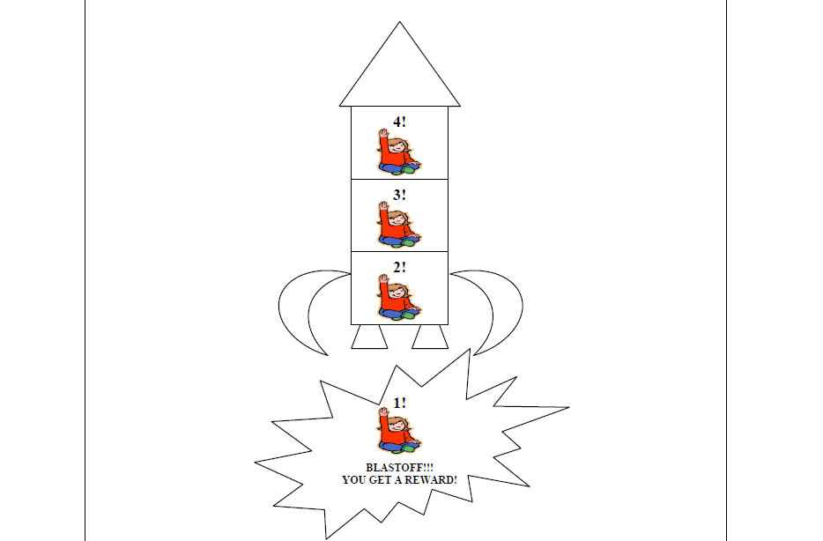
Sample recording sheet for a frequency system
Notes:
Sample recording sheet for a frequency criterion
Instructions: Each time the student raises her hand to ask a question, she circles the picture of the girl raising her hand. She starts at 4 and counts down to 4 (for a total of 4 hand raises). When she gets to 1, she earns a reinforcer.

Slide 11
Step 1: DATA Collection system
Identify the initial criterion for the target behavior
  i.e. the number of times the learner must demonstrate the behavior
  Should be set low enough so that the learner RAPIDLY earns the reinforcer
Notes:
If the goal is to increase a desired behavior, the initial criterion (i.e., the number of times the learner must demonstrate the behavior) should initially be set low enough so that the learner rapidly earns the reinforcer. For example, if the goal is to increase hand-raising in class and the learner rarely raises her hand, the initial criterion may be set at one hand-raise to earn the reinforcer.
If the goal is to decrease an interfering behavior, the initial criterion (i.e., the number of times that the learner can demonstrate the behavior in the given time period) should initially be set high enough so that the learner is likely to be successful. For example, if a learner with ASD hits his peers about five times on average during free play, the initial criterion may be set at five or less hits during free play to earn the reinforcer. Similar to the interval system, information obtained from observing the learner’s performance before the intervention begins should guide the selection of the initial criterion.

Slide 12
Implementing a
Self Management System
Step 1: PREPARE THE SYSTEM
Step 2: TEACH student to use the SYSTEM
  Demonstrate Correct Behavior
    Provide the description in understandable form
      Increase correct behavior
      Decrease by demonstration of acceptable alternatives
    Prompt to demonstrate correct behavior
    Reinforce correct demonstrations
    Fade prompts until consistent / independent demonstration

Slide 13
Implementing a
Self Management System
Step 1: PREPARE THE SYSTEM
Step 2: TEACH student to use the SYSTEM
  Discriminate Behaviors
    Model examples / non-examples
    Prompt as needed
    Reinforce correct discriminations
    Fade Prompts until consistent / independent
  Teach to use the recording system

Slide 14
Implementing a
Self Management System
Step 1: PREPARE THE SYSTEM
Step 2: TEACH to use the SYSTEM
Step 3: IMPLEMENT with Adult Support
  Provide materials / Teach student to independently gather materials
  Provide cues / prompts to signal time to use the system
  TEACH to self-record (prompt, reinforce, fade)
  TEACH to access reinforcement when criterion reached

Slide 15
Implementing a
Self Management System
Step 1: PREPARE THE SYSTEM
Step 2: TEACH to use the SYSTEM
Step 3: IMPLEMENT with Adult Support
Step 4: Promote Independence with the System
  Fluency / Accuracy with Implementation
  Fade Prompts
  Intermittent Checks
  Increase Criterion
  Increase Time
  Increase Locations
  Generalization

Slide 16
Examples of Self-Management Systems

Slide 17
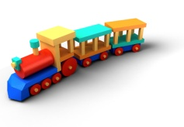
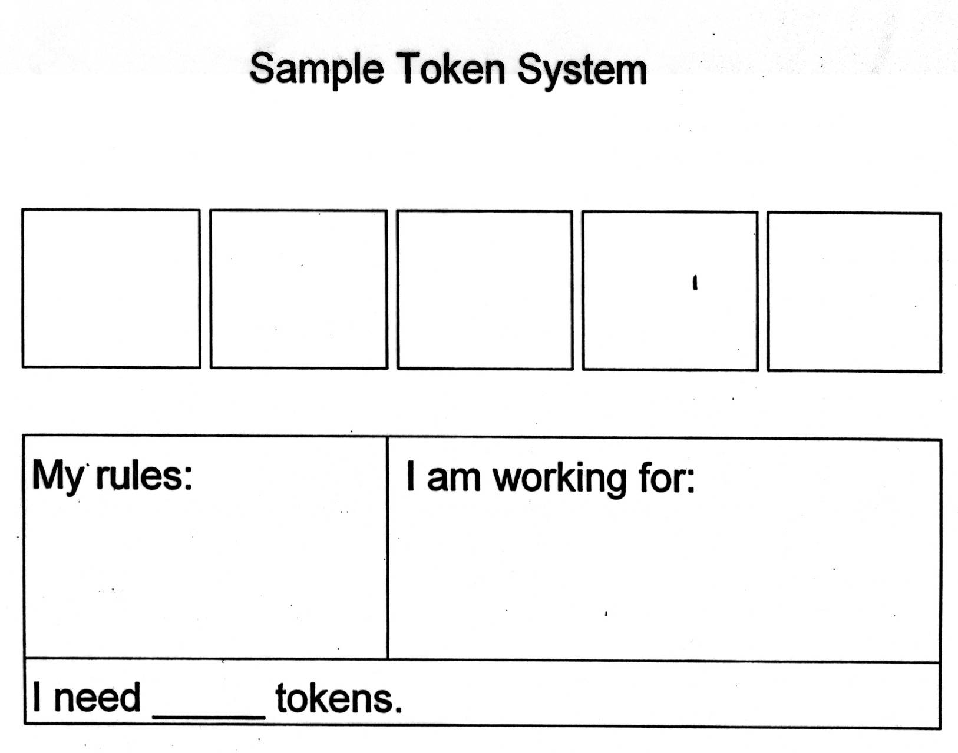
Raise my hand
Use nice words
My Train book

Slide 19
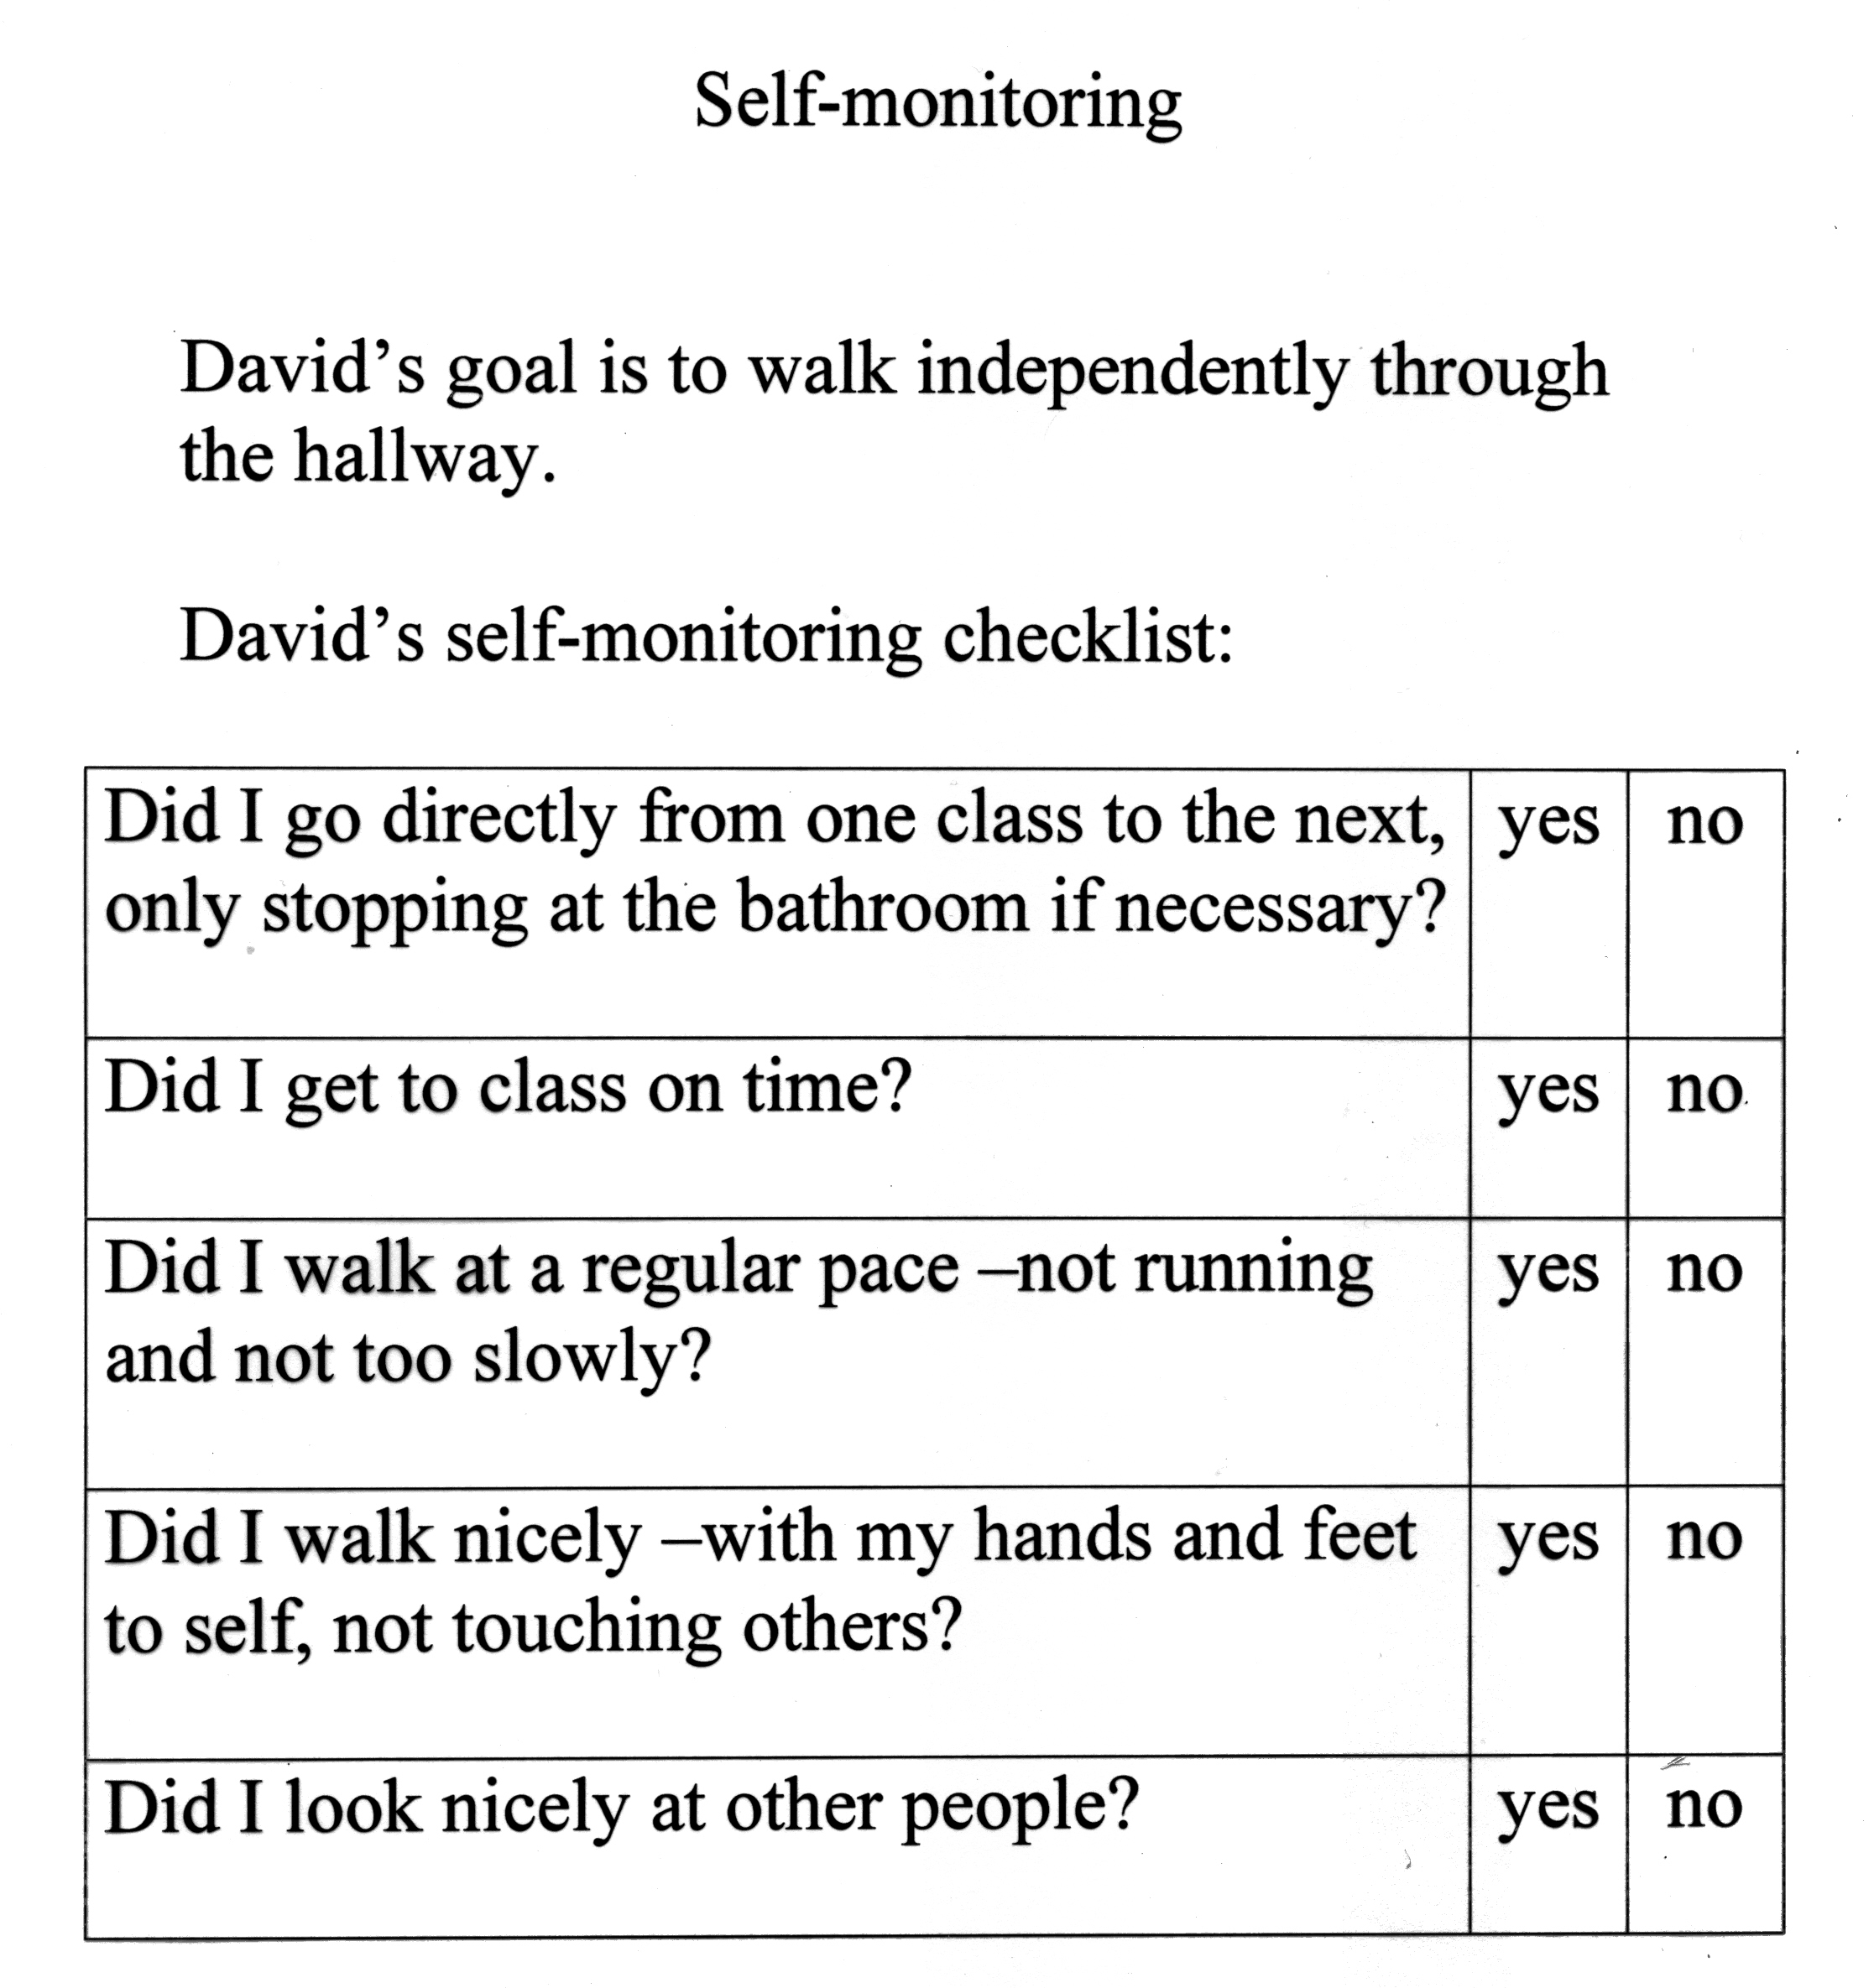

Slide 20
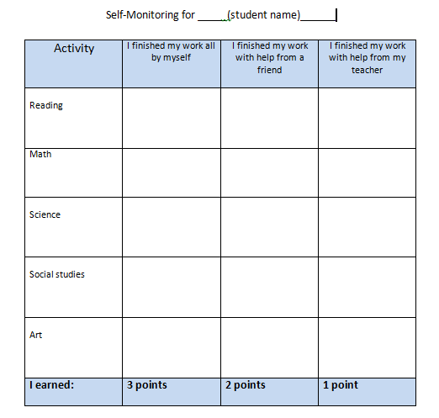

Slide 21
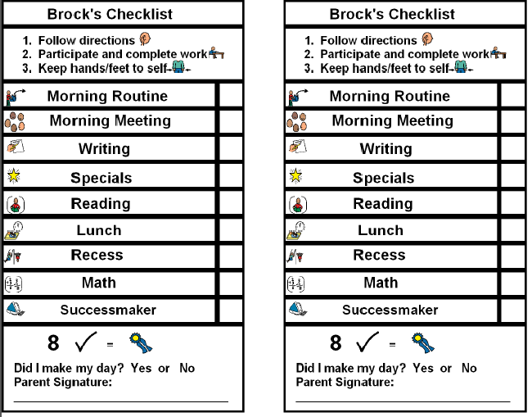
Notes:
Checklist mgt system for gen ed

Slide 22
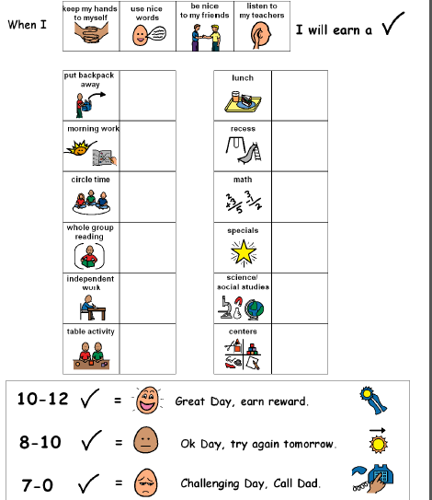
Notes:
Daily check system

Slide 23
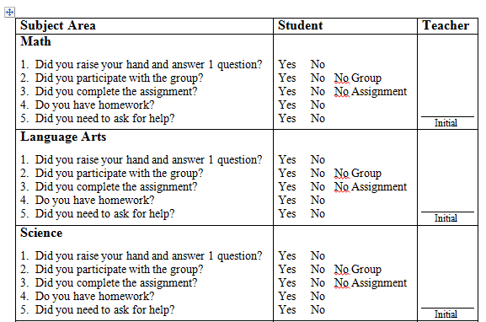
Notes:
Self-mgt example 5

Slide 24
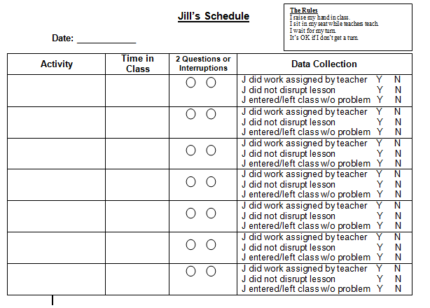

Slide 25
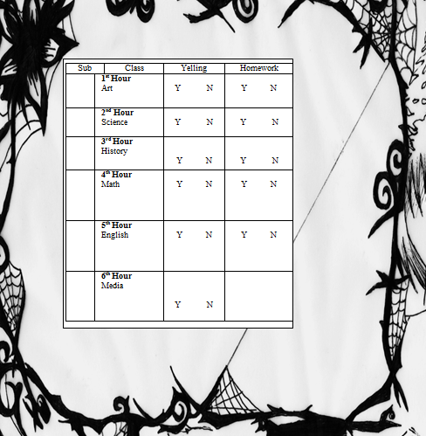
Notes:
Self-mgt example 7

Slide 26
Lexie’s Self-Management System

Slide 27
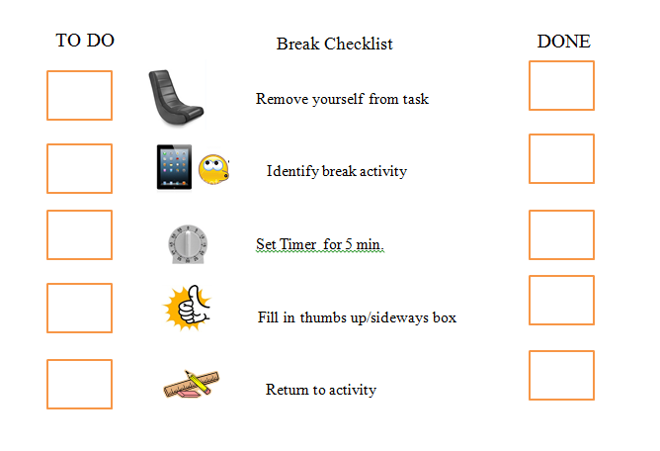
Notes:
Self-mgt system for break

Slide 28
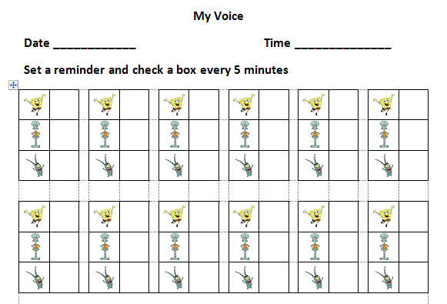
Notes:
Self-mgt example 3

Slide 29
Incredible 5-Point Scale
Self-Management Examples

Slide 30
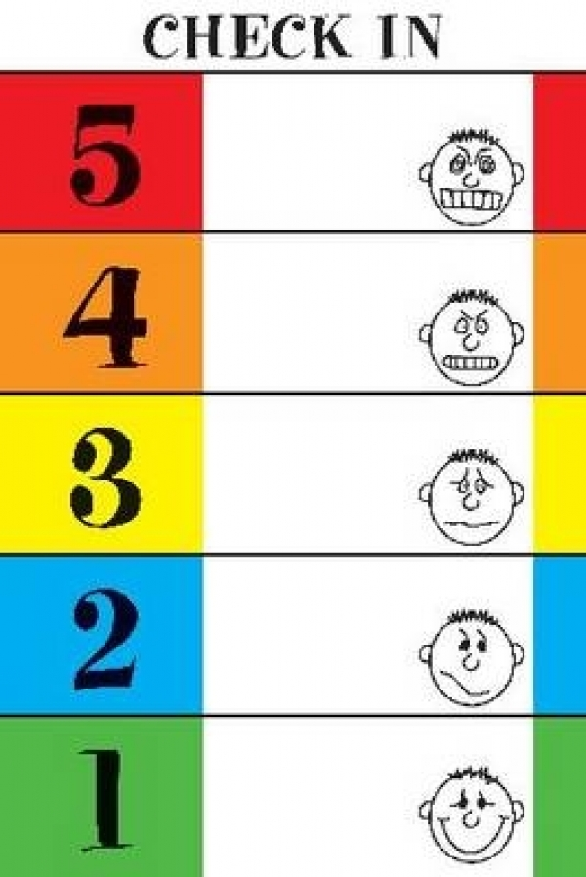

Slide 31
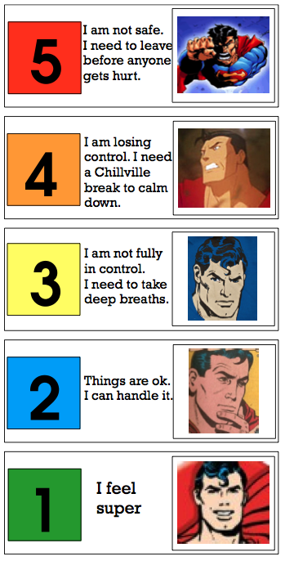

Slide 32
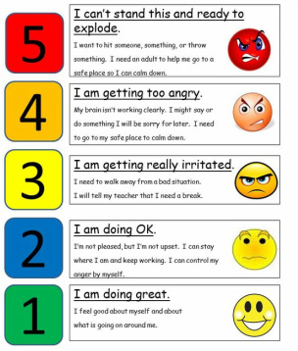

Slide 33
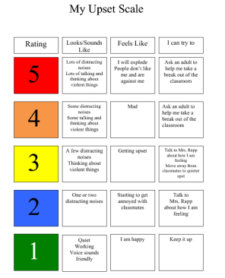

Slide 34
